Slide 1
FP Growth Tree

Slide 2
The two primary drawbacks of the Apriori Algorithm are:-
At each step, candidate sets have to be built.
To build the candidate sets, the algorithm has to repeatedly scan the database.
These two properties inevitably make the algorithm slower. To overcome these redundant steps, a new association-rule mining algorithm was developed named Frequent Pattern Growth Algorithm.
It overcomes the disadvantages of the Apriori algorithm by storing all the transactions in a Trie Data Structure.

Slide 3
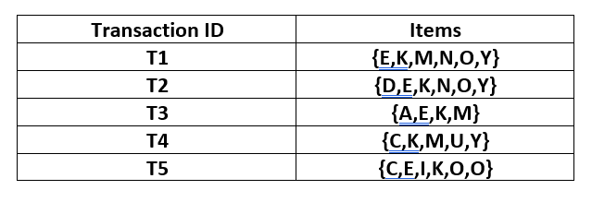
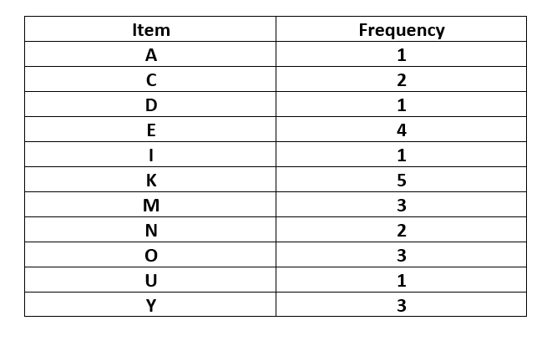

Slide 4
Let the minimum support be 3.
A Frequent Pattern set is built which will contain all the elements whose frequency is greater than or equal to the minimum support.
These elements are stored in descending order of their respective frequencies. After insertion of the relevant items, the set L looks like this:-
L = {K : 5, E : 4, M : 3, O : 3, Y : 3}
Now, for each transaction, the respective Ordered-Item set is built.
It is done by iterating the Frequent Pattern set and checking if the current item is contained in the transaction in question.
If the current item is contained, the item is inserted in the Ordered-Item set for the current transaction. The following table is built for all the transactions:-

Slide 5
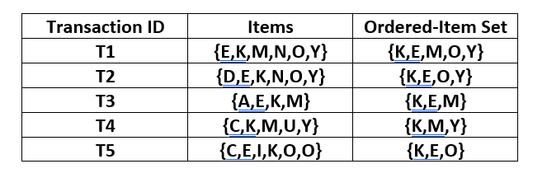
L = {K : 5, E : 4, M : 3, O : 3, Y : 3}

Slide 6
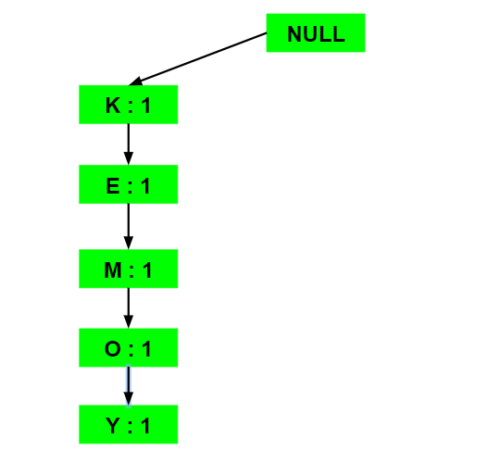
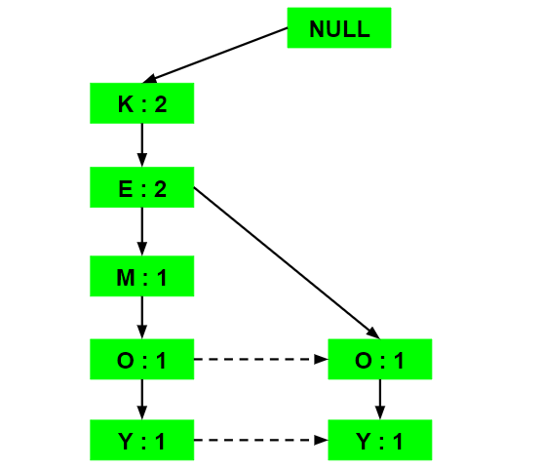
a) Inserting the set {K, E, M, O, Y}:
b) Inserting the set {K, E, O, Y}:

Slide 7
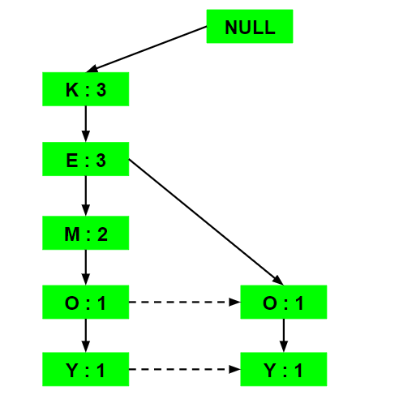
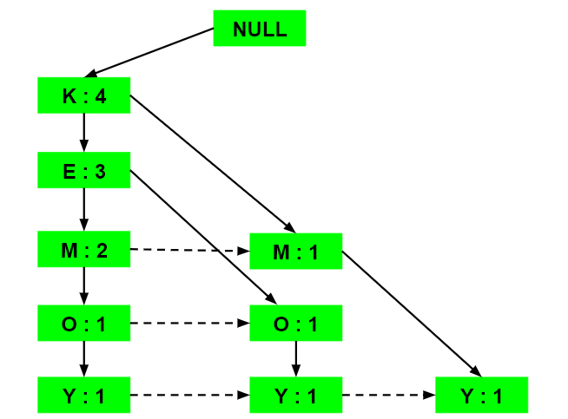
c) Inserting the set {K, E, M}:
d) Inserting the set {K, M, Y}:

Slide 8
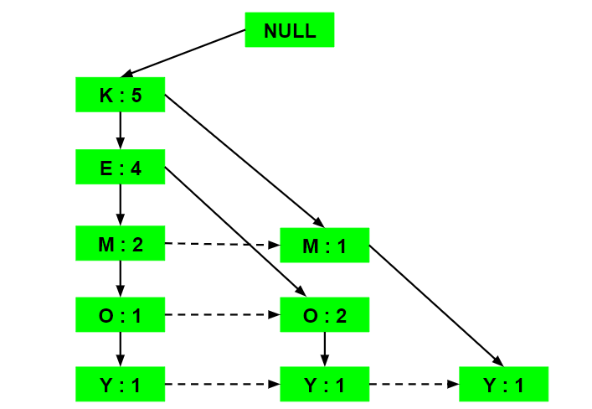
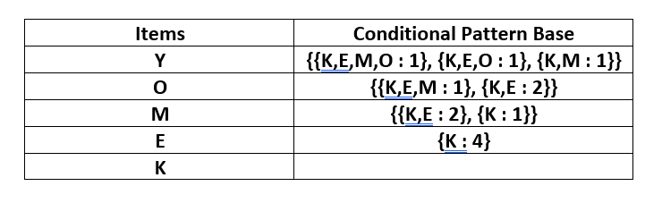
e) Inserting the set {K, E, O}:

Slide 9
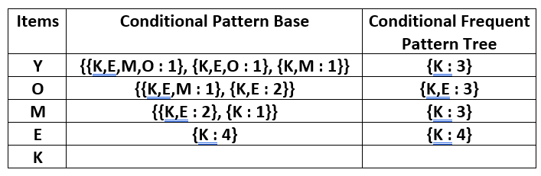
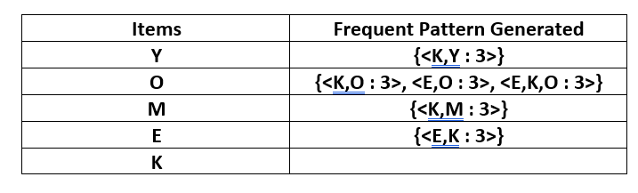

Slide 10
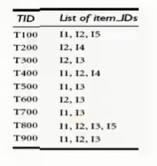

Slide 11
